Slide 1
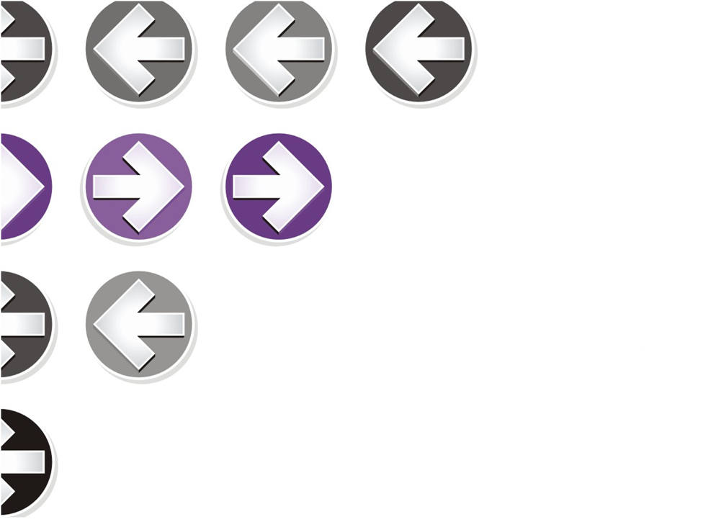

Unified Functional Testing - Learning Guide
-CDW Automation Team

Slide 2
Introduction To uft
Unified Function Testing (UFT) is a Functional Testing Tool.
Latest version of UFT (14.52) can be used to test GUI as well as API part of Application.
Unlike Selenium, UFT is licensed Tool. We need to contact HP to get license.

Slide 3
UFT requirements
Operating System:- Win 7,8,8.1,10 (Except XP)
Computer Processor:- > 1.6 GHz
RAM :- 2GB RAM
Graphics Card:- Graphics card with 64MB video memory.
Hard Disk space:- 2GB free hard disk space for supporting files and results storage.
Note:- Above details are minimum System requirements.

Slide 4
HOW IT WORKS
UFT automates functional test by recording the actions of a user on the system under test and replaying the actions to execute a test.
The recorder actions are stored in UFT as a simple program known as script.
Script can be displayed as Simple VB script (Expert view), or as a sequence of steps labelled as icons (Keyboard View)
The tool can test the success or failure with checkpoint, comparing the actual and expected results.

Slide 5
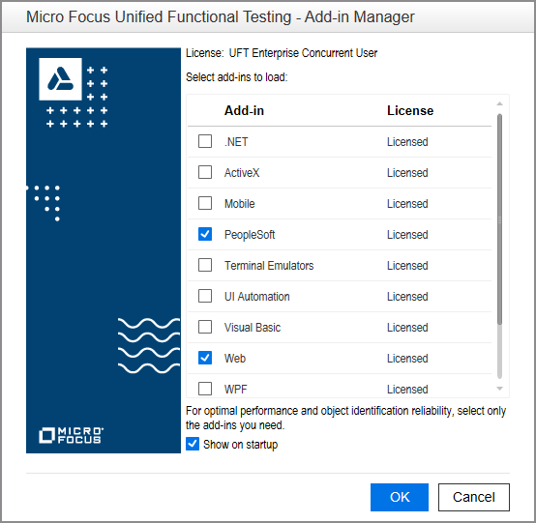
UFT Add-ins and AdD-in Manager

Slide 6
UFT Add-ins and AdD-in Manager
Add-ins in UFT are a way to ensure that tool identifies the object in corresponding environment.
For Ex:-If we are testing JAVA based application, JAVA add-ins should be selected.
Unlike selenium, UFT can be tested in both Windows and Web based application.
Find attached document for list of all Add-ins supported by UFT.

Slide 7
UFT panes
Solution Explorer pane
Tool Box pane
Document Pane
Canvas pane
Keyword view and editor pane
Output pane
Active screen pane
Data pane
Debug panes
Errors pane

Slide 8
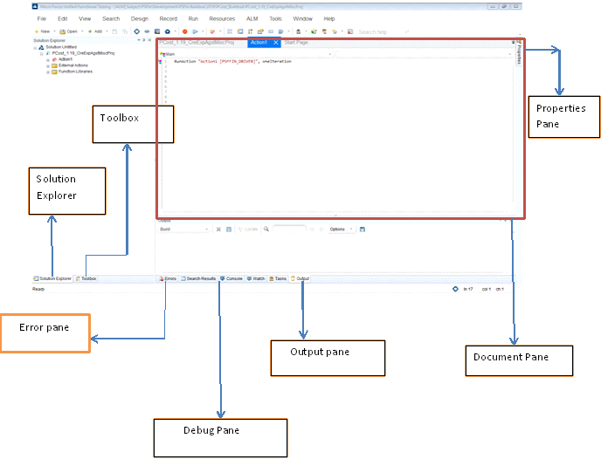
UFT Panes

Slide 9
Objects and Object Recognition
All GUI elements such as Edit box, buttons, links are considered as Objects.
UFT recognizes this objects and store representations of them in Repository during development of script.
During Execution, UFT verifies the stored object (Repository) with run time object(Application) with the details. If matches, corresponding actions will be performed.

